Slide 1

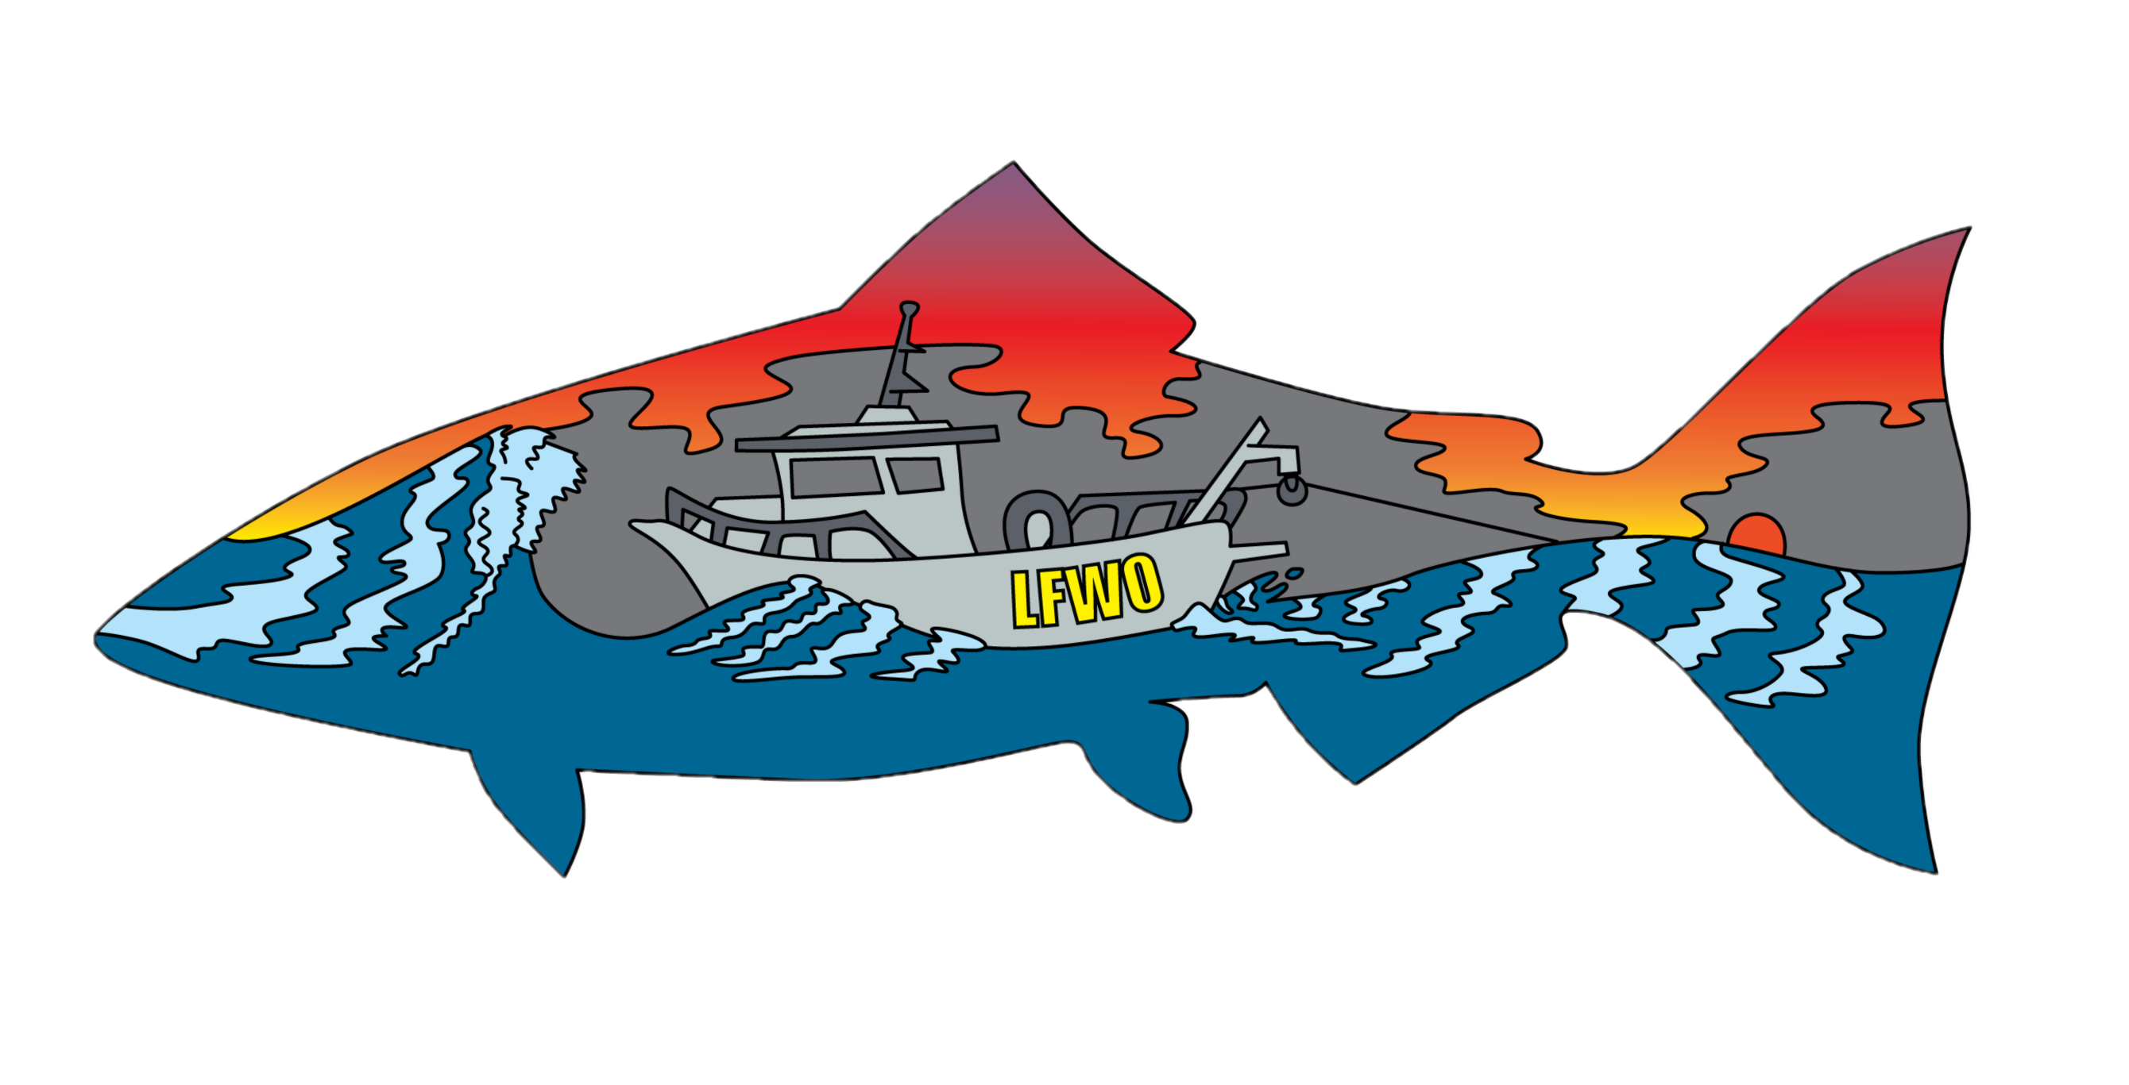
Database QC using R
Morgan D. Gilbert
LFWO
Notes:
Good morning everyone! We’re here to talk to you about some changes coming to the way our database QA/QC is done by incorporating a program using R to help locate data entry errors.

Slide 2
Roadmap
About myself and the DJFMP.
Previous methods of database QC at LFWO.
Why we selected R.
Birds-eye view of the solution.
Challenges and future steps
Questions and comments!
Notes:
Good morning everyone! We’re here to talk to you about some changes coming to the way our database QA/QC is done by incorporating a program using R to help locate data entry errors.

Slide 3



About me
Fish Biologist, U.S. Fish and Wildlife Service, Lodi Fish and Wildlife Office
Delta Juvenile Fish Monitoring Program (DJFMP)
Liberty Island Monitoring Project
Enhanced Delta Smelt Monitoring
20mm & experimental larval sampling
R Background: Intermediate, primarily analytical.

Slide 4
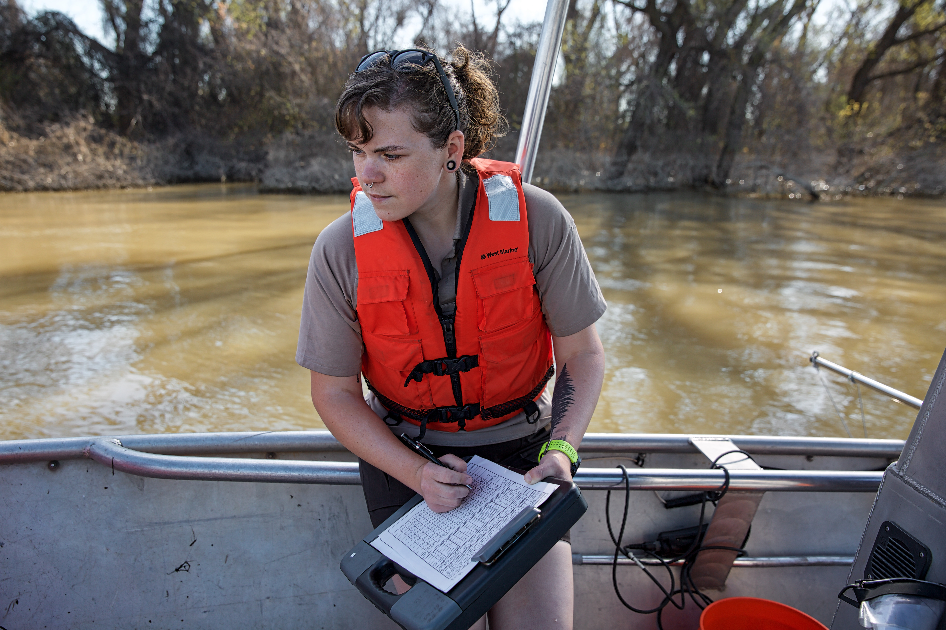
The DJFMP
Established 1976 - over 40 years of data collected!
Initially focused on beach seines, later incorporated midwater trawls.
Important source of data on fish populations within the Delta and particularly for Chinook Salmon.
Immense effort, encompassing 20+ field crew operating year-round.
263,000 sampling events
with environmental+habitat data
Millions of individual fish.
Lots of data!

Slide 5
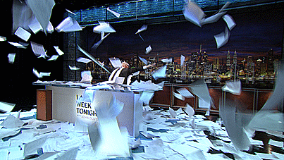

Slide 6

Database QC
Quality control check of data is crucial.
Method: Line by Line
Comparing printed database entries with datasheets or second entry to locate errors.
Effective at spotting most errors!

Slide 7

Database QC
Method: Line by Line
Functional
… but very labor intensive.
Variable effectiveness – not all errors caught.
Relatively slow.

Slide 8
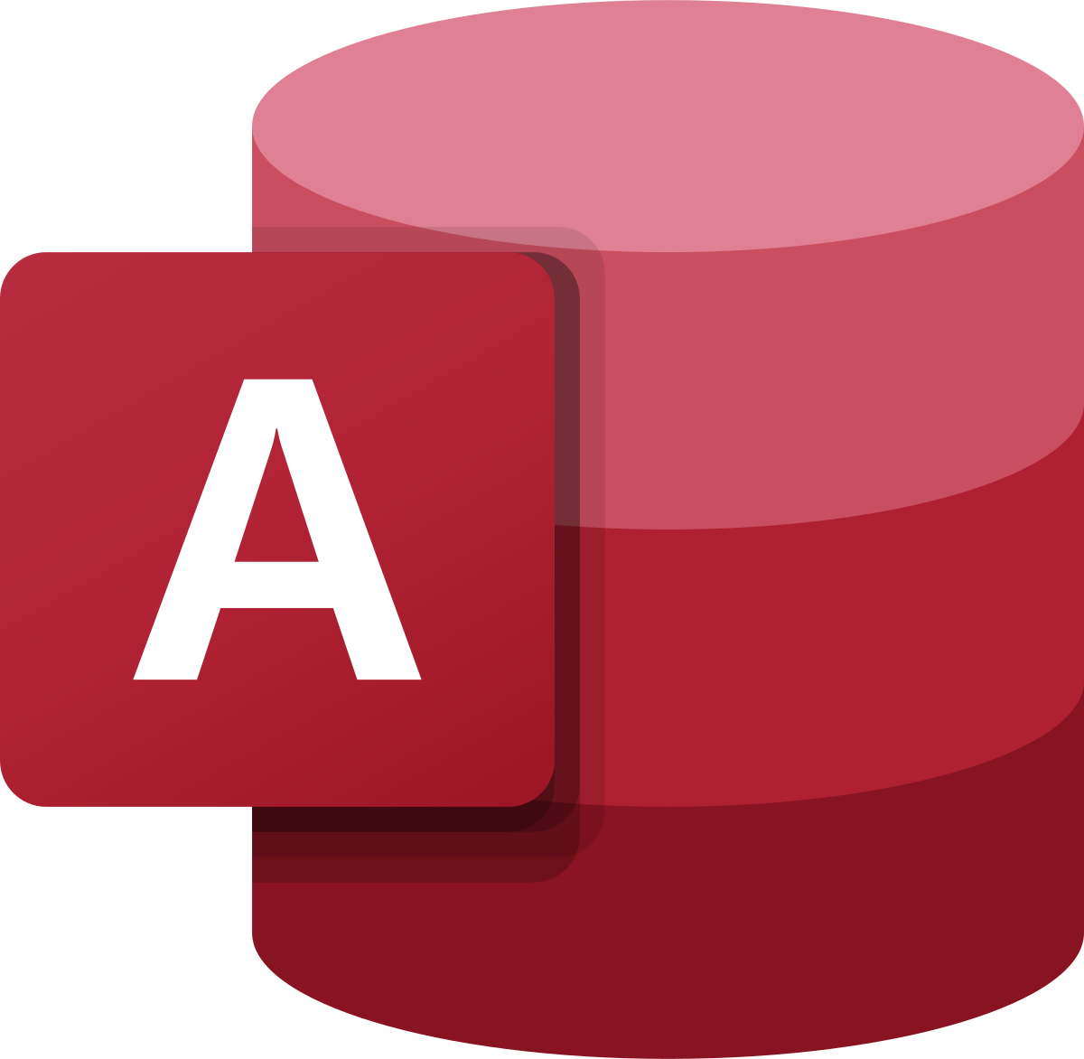
Comparisons in Access
Method: Double Entry
First Entry
Second Entry
Data QC in Access
Method & queries initially developed by Red Bluff FWO.
Compares the first/second entry databases.
Shows the approximate location of errors.
Less labor intensive than line by line.
Much more reliable capture of many errors.

Slide 9

Access has Issues
Requires precisely sequential entry of some data (especially fish).
Output is sometimes difficult to interpret.
Comparisons miss some common errors
Difficulty handling blanks within data, either as error or intentional input.
Capitalization and other formatting.
These issues greatly increase the volume of QC corrections.
Particularly as LFWO programs move toward submitting data to organizations like the Environmental Data Initiative (EDI), producing high quality data is a major concern!

Slide 10

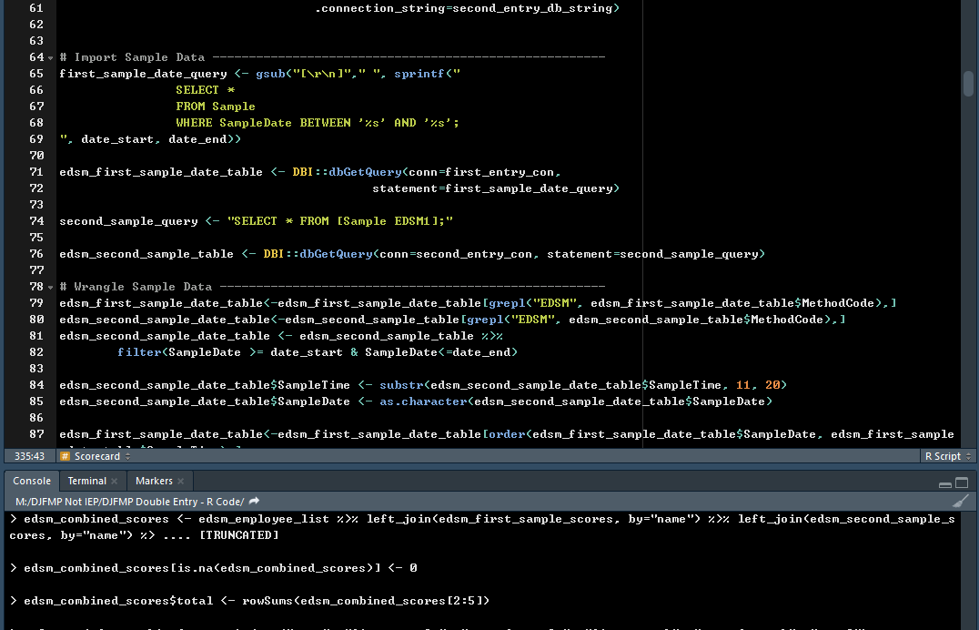
R as a Solution
Easily handles blanks in data (“NA”)
Handles non-sequential data.
Sensitive to formatting.
Highly customizable output.
Many data “customers” will primarily use R in their analysis.

Slide 11
Step 1: Import Data
Library
Acquire data from both the remote first entry database and the local second entry database.
Coding magic to execute SQL queries in R.
odbc

Slide 12
Step 2: Wrangle Data
Library
Carry out various transformations to prepare data for comparison, primarily to standardize formatting, highlight missing variables, constrain comparison to certain dates, etc.
Problem: No linking sample ID between databases.
Solution: Create sample ID using station code, date, and time.
odbc
dplyr + tidyr
lubridate

Slide 13
Step 3: Compare Data & generate output
Library
odbc
dplyr + tidyr
lubridate
compareDF
Locate discrepancies between the two databases by comparing each table to it’s twin.
Save the comparisons and other outputs (error counts, etc) to file.

Slide 14
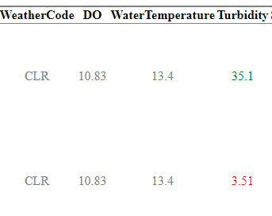
How the output works
We use a package called compareDF to conduct a git-style comparison between the two databases. Only lines with errors are displayed, and errors are highlighted in color.
1
2
First Entry
Second Entry
Values from the first entry database that don’t match those in the second are highlighted in green.
Values from the second entry database that don’t match those in the first are highlighted in red.
Notes:
I decided to use a package called compareDF, which generates a git-style comparison between the two databases tables. If you aren’t familiar with the term, git-style just means that differences are presented in color – in this case green and red – and matching values are displayed in gray. Rows where there are no mismatches are not displayed at all, meaning that if a sample shows up in our output, it needs our attention. The colors compareDF tell us a little bit about where our data is coming from. As you can see here, values highlighted using green are in the first entry database, while those in red are present in the second entry database. Because these two are different, likely due to a typo, they’re shown here in color.

Slide 15
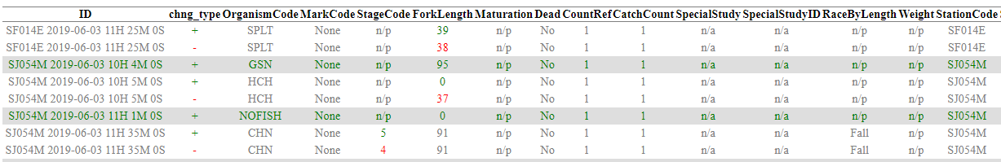
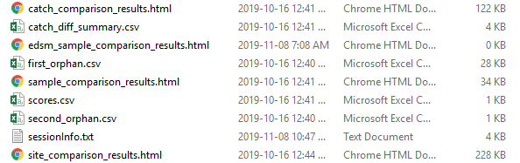
Finding and interpreting errors.
Grouped red and green rows (with the same shading) are from the same sample (tow, seine site, etc) and have some form of discrepancy between them.
Lone lines (where only a single color is highlighted) are orphans, where a record exists in only one database.
Other outputs list orphan samples (i.e., whole samples that are present in only one database) and summary statistics that can help diagnose database problems.
Notes:
Generally, when compareDF finds differences between the two databases, it results in multiple rows showing all of the values that don’t match. When one database is missing a record entirely, it appears as a single line. These orphans are highlighted all the way across, and probably indicate that the other data has not yet been entered. The program also generates a few other outputs, including summary information that can be useful in figuring out certain errors.

Slide 16
Lessons Learned
Small differences between databases lead to big obstacles later.
Building for database interoperability will save you a lot of pain.
Majority of coding time was devoted to resolving small differences in formatting (particularly time & date).
Grouping information (dates, times, station codes and crew names) are critical elements for comparison and should be carefully formatted.
No database QC method is perfect.
Interpreting outputs.
Access comparisons still situationally useful.

Slide 17

Future directions
Acknowledgements
Expanding and improving this code.
Feedback wanted! Packages, techniques, other input?
Incorporating these techniques into other DJFMP databases.
EDSM
Liberty Island
Creating documentation, package library, and producing usable (and re-usable) code to ensure program resiliency.
Lara Mitchell, Jon Speegle, Brian Mahardja, Cory Graham, Ryan McKenzie.
Current version:
https://github.com/morgan-gilbert/DJFMP-Double-Entry---R-Code
Notes:
Thank you all for coming! If you’re interested in further reading on how this program works, the code and it’s accompanying documentation are available on the M drive. We have a lot of exciting ideas for contuing to develop this technique, and we’d love to hear yours! Before I take any questions y’all might have, I’d like to thank Lara Mitchell, Brian Mahardja, and Cory Graham for their invaluable input throughout the conception and implementation of this process.

